Slide 1


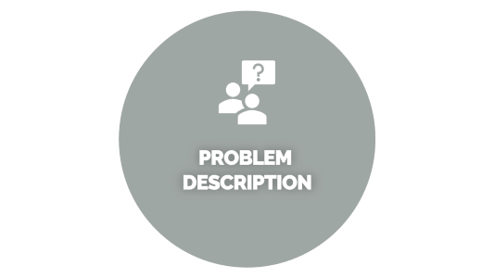
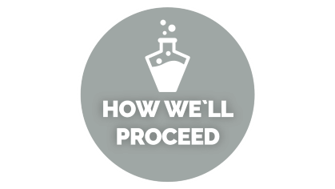
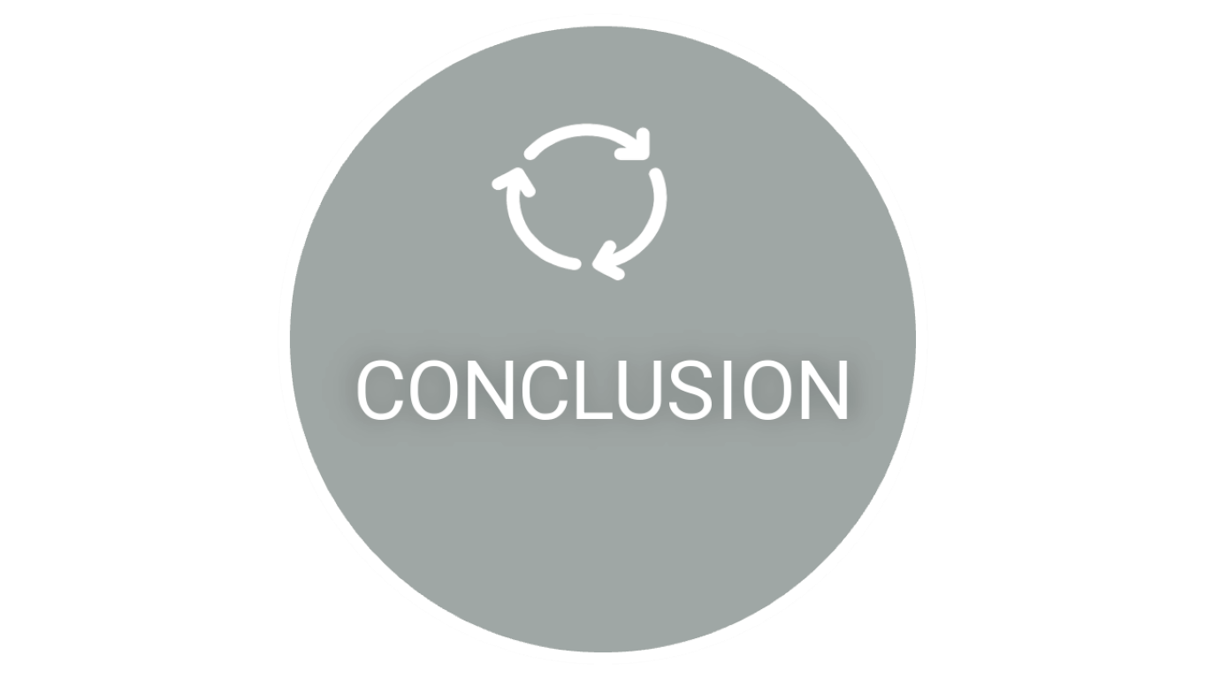
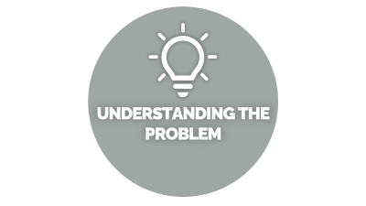
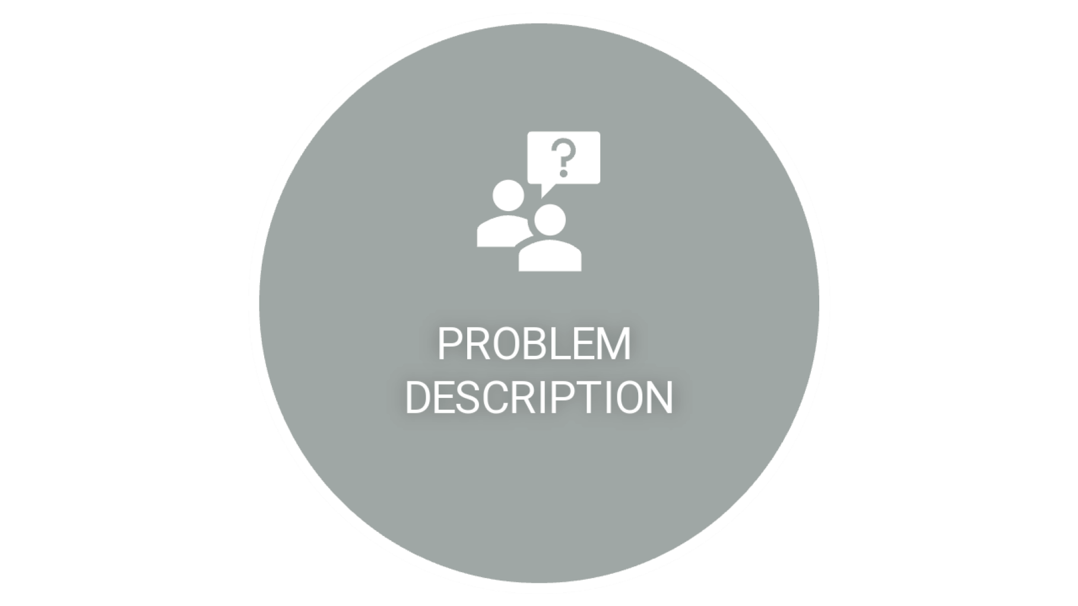
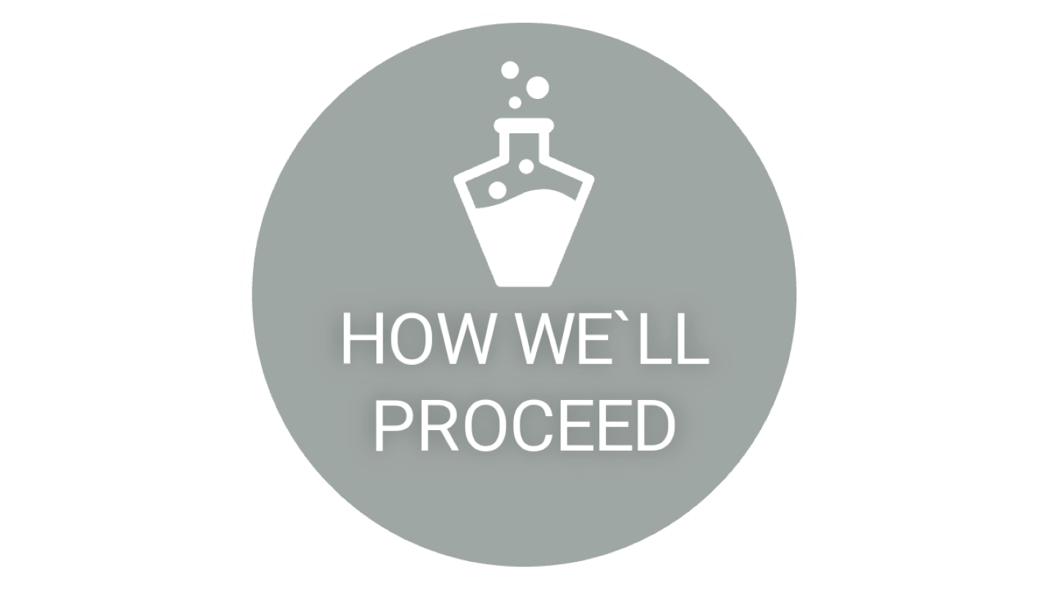


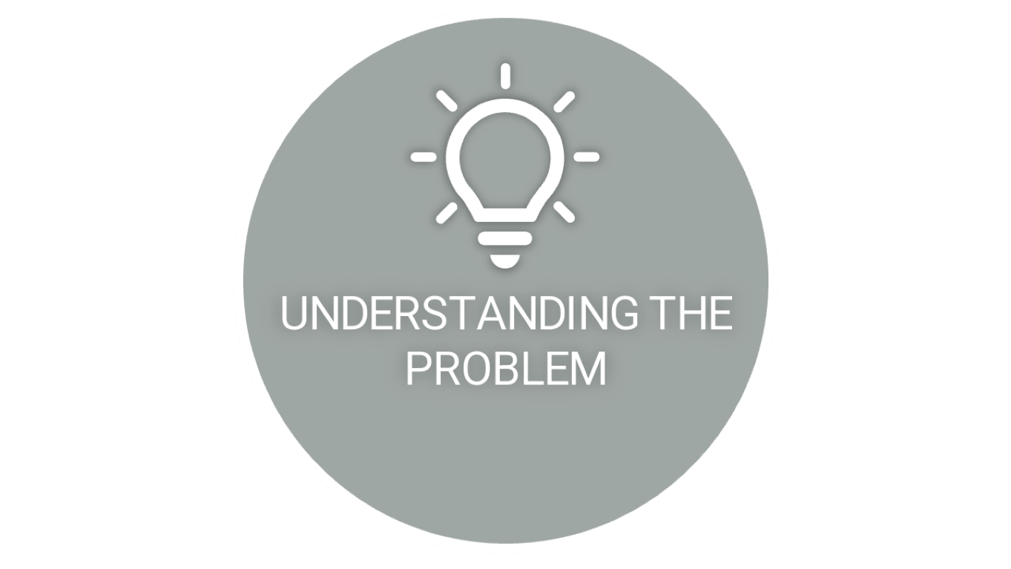
CUSTOMER CHURN PREDICTION
Notes:
https://unsplash.com/photos/AXu2aZ3YgP8

Slide 2

PROBLEM
DESCRIPTION

Slide 3


PROBLEM DESCRIPTION
In this presentation, I'll be discussing our project on "Customer Churn Prediction." We will explore how data analytics can be used to predict customer churn and identify the key factors influencing customer retention. The goal of this project is to help businesses reduce customer attrition and enhance their customer retention strategies.
Notes:
https://unsplash.com/photos/fItRJ7AHak8

Slide 4

UNDERSTANDING THE
PROBLEM

Slide 5


UNDERSTANDING THE PROBLEM
To tackle this problem effectively, we need to understand it thoroughly. Customer churn is influenced by various factors, including:
Customer Demographics:-
Age, gender, location, and other demographic factors can play a role in churn. For example, younger customers might be more tech-savvy and have different preferences. Usage Patterns:-
How often and in what ways do customers use our services or products? Identifying usage patterns can help us pinpoint potential churners. Customer Support Interactions:-
Negative experiences with customer support can lead to churn. Analyzing support interactions and feedback can be crucial. Competitor Activity:-
What are our competitors doing, and how does it affect our customers' decisions? Understanding the competitive landscape is essential. Pricing and Promotions:-
Changes in pricing or promotions can impact customer loyalty.
Notes:
https://unsplash.com/photos/48nerZQCHgo

Slide 6

HOW WE`LL PROCEED

Slide 7


HOW WE`LL PROCEED…
Data Collection:- The first step is gathering relevant data. This may include customer profiles, transaction history, customer support logs, competitor data, and more.
Data Cleaning:- We'll clean and preprocess the data to ensure it's accurate and ready for analysis. This involves handling missing values, outliers, and ensuring data consistency.
Exploratory Data Analysis (EDA):- We'll conduct EDA to gain insights into our data. We'll visualize customer behavior, identify patterns, and examine correlations between variables.
Feature Selection:- Not all features are equally important. We'll select the most relevant ones that impact churn prediction.
Model Building:-Using machine learning algorithms like logistic regression, decision trees or neural networks, we'll build predictive models to identify potential churners.
Model Evaluation:- We'll evaluate the models' performance using metrics like accuracy, precision, recall, and F1-score to ensure their effectiveness.
Deployment:- we have a reliable model, we'll integrate it into our business operations, allowing real-time.
Continuous Monitoring:- Customer behavior can change over time, so we'll continuously monitor and update our model to stay effective..
Notes:
https://unsplash.com/photos/TvN54bnuQg8

Slide 8

BENEFITS AND
CHALLENGES

Slide 9


BENEFITS
Reduced Churn: The primary benefit is a reduction in customer churn, leading to increased customer retention and revenue.
Cost Savings: Acquiring new customers is more expensive than retaining existing ones. Reducing churn can lead to substantial cost savings.
Improved Customer Service: Identifying pain points from support logs allows for targeted improvements in customer service.
Competitive Advantage: Understanding competitor activities helps us stay ahead in the market.
CHALLENGES
Imbalanced Data: Churned customers may be a minority class, leading to imbalanced datasets. We'll need to address this during model training.
Data Privacy: Ensuring the privacy and security of customer data is paramount. We need to comply with data protection regulations such as GDPR or HIPAA.
Feature Engineering: Creating meaningful features from raw data can be complex but is crucial for model accuracy.
Model Interpretability: Understanding why a model makes specific predictions is essential for implementing effective retention strategies.
Notes:
https://unsplash.com/photos/GKLIsLZxhj0

Slide 10

CONCLUSION

Slide 11

CONCLUSION
By the end of this project, we aim to provide our business with a powerful tool to predict customer churn and identify the factors influencing it. This will enable us to implement targeted retention strategies, ultimately leading to improved customer satisfaction and business success.
Notes:
https://unsplash.com/photos/fItRJ7AHak8

